Slide 1
AI618
Generative Model and Unsupervised Learning
Spring 2024
Individual Project. Unsupervised CT Denoising with CycleGAN
TA Dohun Lee
Dept. of Kim Jaechul Graduate School of AI, KAIST

Slide 2
Goal of the project
Individual Project: Unsupervised CT Denoising with CycleGAN
Understand the task of CT denoising
Understand CycleGAN
AAPM dataset
Implement CycleGAN
Report

Slide 3
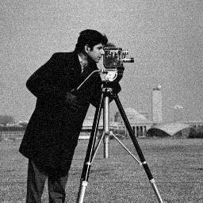
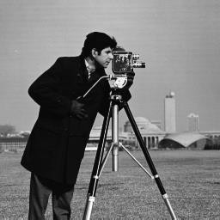
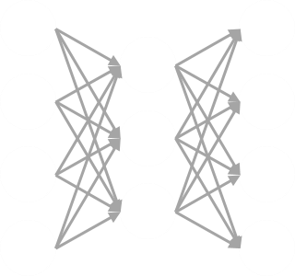
1. CT Denoising
Noisy input
Clean image
Neural network
Y = X + N
X
Denoising: recover clean image from the noisy input image

Slide 4
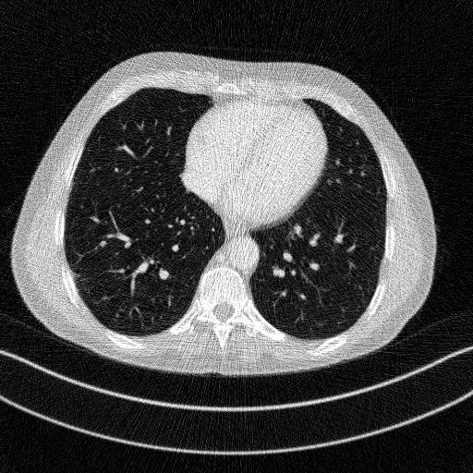

1. CT Denoising
Low dose
High dose
Neural network
Reduce the radiation dose ➔ high level noise, low image contrast
CT denoising: remove the noise in low dose CT images
Supervised learning: low&high dose paired data ➔ increase the radiation dose

Slide 5
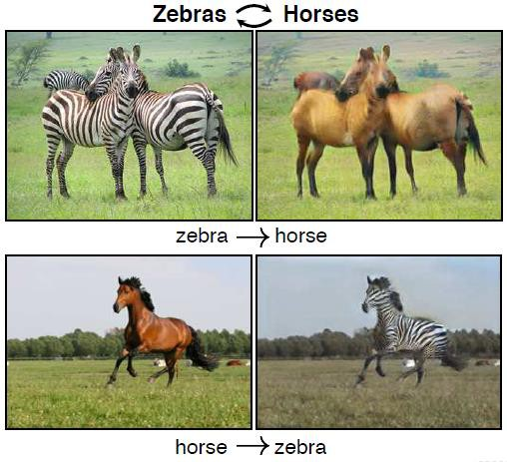
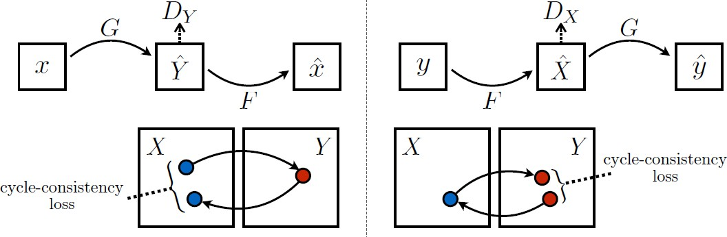
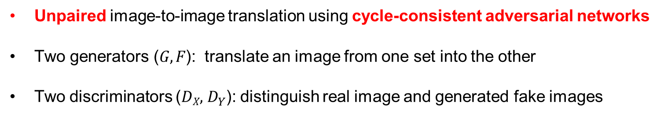
2. CycleGAN
𝐺: horse to zebra / 𝐹: zebra to horse
𝐷_{𝑋}: real or fake horse / 𝐷_{𝑌}: real or fake zebra
[1]
Unpaired image-to-image translation using cycle-consistent adversarial networks
Two generators (𝐺, 𝐹): translate an image from one set into the other
Two discriminators (𝐷_{𝑋},${ D}_{Y}$): distinguish real image and generated fake images
[1] Zhu, et al. “Unpaired image-to-image translation using cycle-consistent adversarial networks" CVPR, 2017.

Slide 6
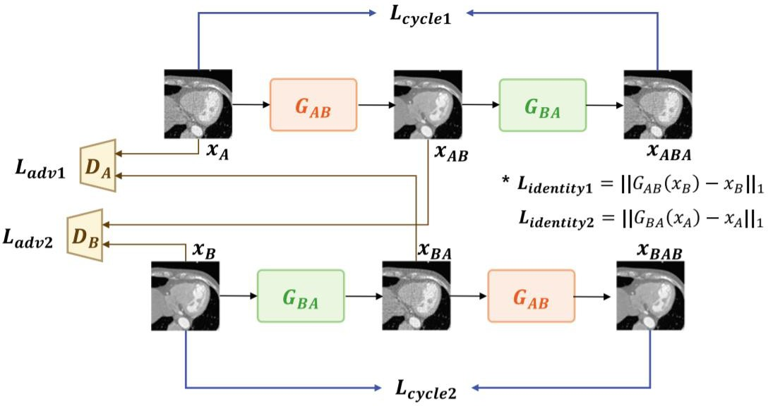
2. CycleGAN
[1]
CT denoising with CycleGAN: low dose ↔ high dose, does not require paired data
You have to implement CycleGAN for CT denoising
[1] Kang, et al. “Cycle-consistent adversarial denoising network for multiphase coronary CT angiography" Medical physics, 2019.

Slide 7
3. AAPM dataset
AAPM: American Association of Physicists in medicine
AAPM 2016 Low Dose CT Grand Challenge
The CT image has an HU range from -1024 to +3071 and consists of 512x512 = 262,144 pixels in one channel.
Air: ~ -1000HU
linear attenuation coefficient (𝜇)
Fat: -50HU ~ -100HU
^{𝜇−𝜇}𝑤𝑎𝑡𝑒𝑟
Water: ~0HU
𝐻𝑈 = × 1000 = ^{𝜇−0.0192} × 1000
^{𝜇}𝑤𝑎𝑡𝑒𝑟^{−𝜇}𝑎𝑖𝑟
0.0192
Bone: +200HU ~ +3000HU

Slide 8
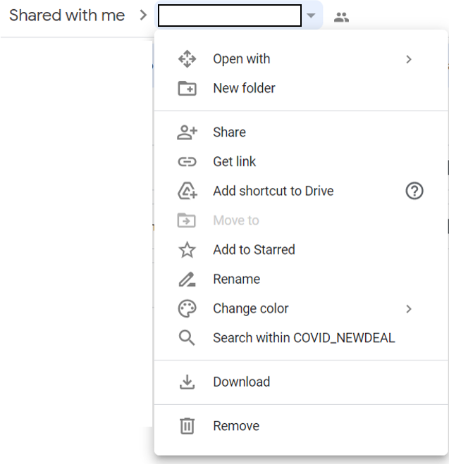
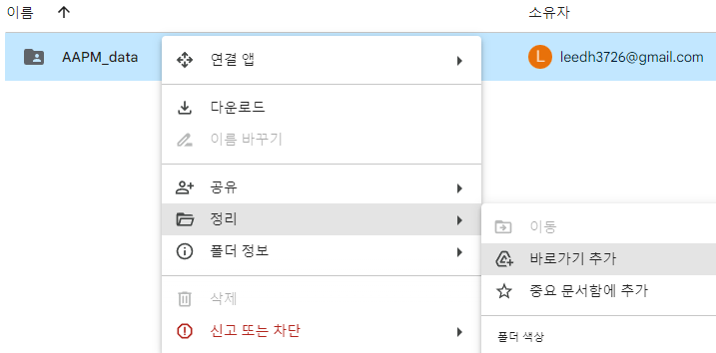
3. AAPM dataset
(1)
AAPM
AAPM dataset (Google Drive link)
https://drive.google.com/drive/folders/1Fj-TVxLXqeULdbDhH5Hu5TEhRbJyY8rr?usp=sharing
AAPM 2016 Low Dose CT Grand Challenge
Training set: 3839 full dose / quarter dose data (paired)
Test set: 421 full dose / quarter dose data (paired)
(2)
1.npy ~ 3839.npy
1.npy ~ 3839.npy
1.npy ~ 421.npy
1.npy ~ 421.npy
AAPM train full_dose
quarter_dose
test
full_dose
quarter_dose
Make a shortcut in your Google Drive

Slide 9
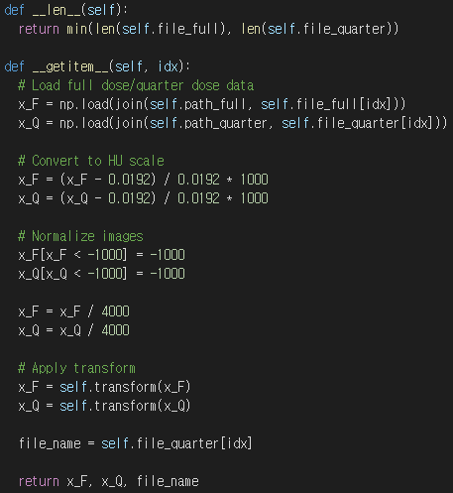
4. Implement CycleGAN – Dataloader
Default: linear attenuation coefficient (𝜇)
➔ change to Hounsfield unit (HU)
^{𝜇−𝜇}𝑤𝑎𝑡𝑒𝑟
- 𝐻𝑈 = × 1000 = ^{𝜇−0.0192} × 1000
^{𝜇}𝑤𝑎𝑡𝑒𝑟^{−𝜇}𝑎𝑖𝑟
0.0192

Slide 10
4. Implement CycleGAN – Dataloader
Clip the value lower than -1000 HU
Normalize the data

Slide 11
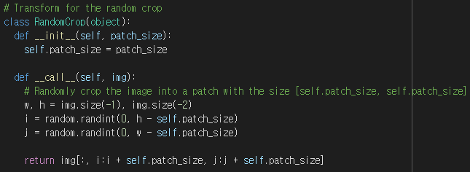
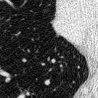
4. Implement CycleGAN – Dataloader
Original image size: 512x512 ➔ too large
Make a small patch for training by random crop
Random crop

Slide 12


4. Implement CycleGAN – Generator
Residual path
Residual learning: faster & more stable convergence, improved performance
You are free to choose the structure of the generator (U-Net, ResNet, etc), but it should contain residual path.

Slide 13
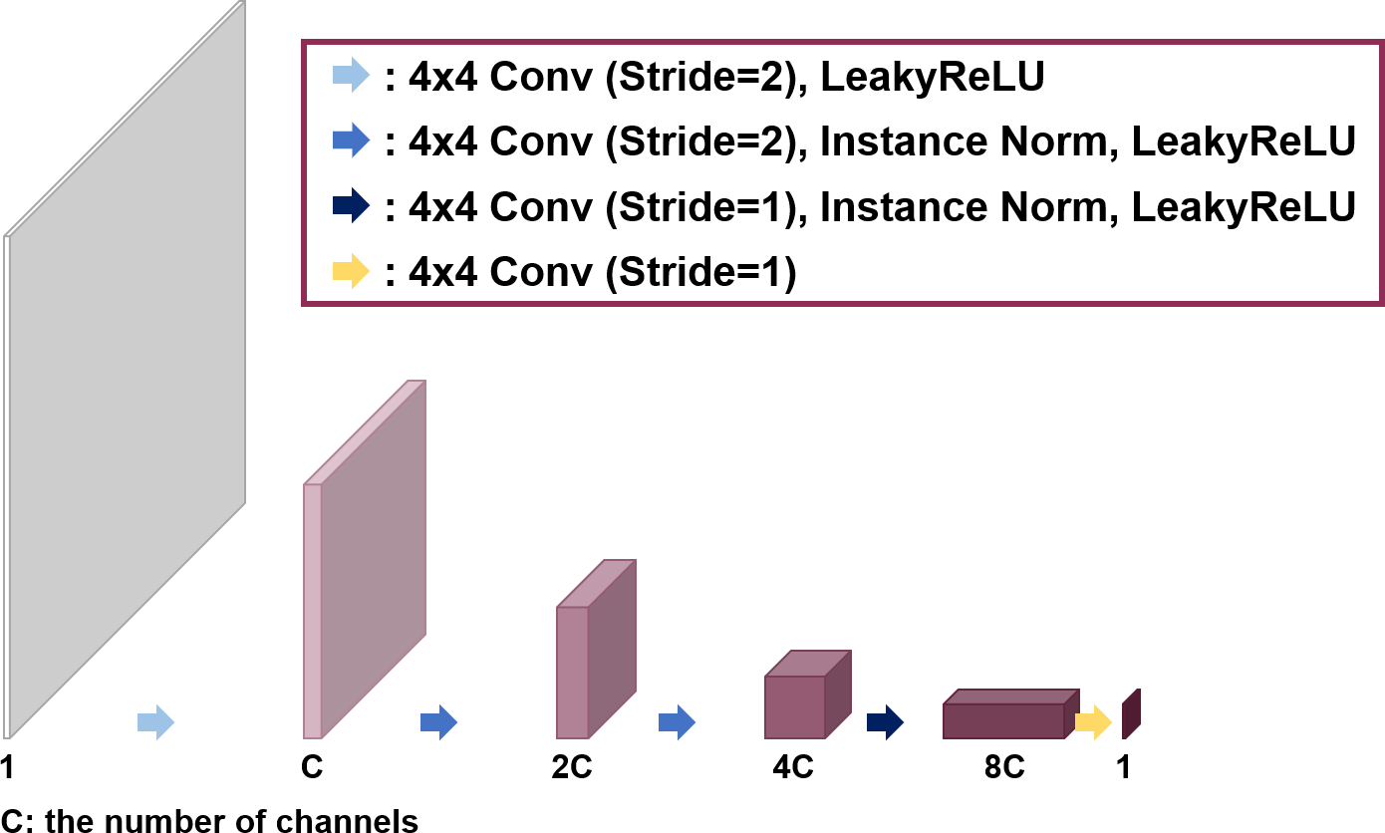
4. Implement CycleGAN – Discriminator
PatchGAN: classifies inputs at patch scale
You have to build PatchGAN structure as the figure (C >= 32).

Slide 14
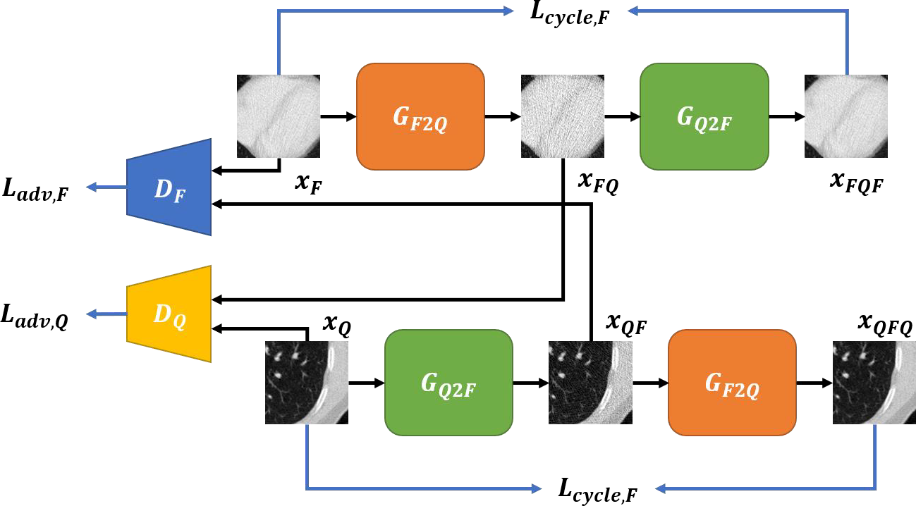
4. Implement CycleGAN – Losses
Adversarial loss (𝐿_{𝑎𝑑𝑣,𝐹} , 𝐿_{𝑎𝑑𝑣,𝑄})
𝐷: distinguishes real/fake images
𝐺: tries to generate fake images that fool 𝐷
Use least squares GAN (LSGAN) loss

Slide 15
4. Implement CycleGAN – Losses
Adversarial loss (𝐿_{𝑎𝑑𝑣,𝐹} , 𝐿_{𝑎𝑑𝑣,𝑄})
- For discriminators
2
2
^{𝐿}𝑎𝑑𝑣,𝐹 ^{= 𝔼}𝑥
𝐷_{𝐹} 𝑥_{𝐹} − 1
+ 𝔼_{𝑥}
𝐷_{𝐹}
^{𝐺}𝑄2𝐹
𝑥_{𝑄}
𝐹
𝑄
2
2
^{𝐿}𝑎𝑑𝑣,𝑄 ^{= 𝔼}𝑥_{𝑄}
𝐷_{𝑄} 𝑥_{𝑄} − 1
+ 𝔼_{𝑥𝐹}
𝐷_{𝑄}
^{𝐺}𝐹2𝑄
𝑥_{𝐹}

Slide 16
4. Implement CycleGAN – Losses
Adversarial loss (𝐿_{𝑎𝑑𝑣,𝐹} , 𝐿_{𝑎𝑑𝑣,𝑄})
- For generators
2
^{𝐿}𝑎𝑑𝑣,𝐹 ^{= 𝔼}𝑥_{𝑄}
𝐷_{𝐹}
^{𝐺}𝑄2𝐹
𝑥_{𝑄} − 1
2
^{𝐿}𝑎𝑑𝑣,𝑄 ^{= 𝔼}𝑥_{𝐹}
𝐷_{𝑄}
^{𝐺}𝐹2𝑄
𝑥_{𝐹} − 1

Slide 17
4. Implement CycleGAN – Losses
Cycle consistency loss (𝐿_{𝑐𝑦𝑐𝑙𝑒,𝐹} , 𝐿_{𝑐𝑦𝑐𝑙𝑒,𝑄})
- Two generators (𝐺_{𝐹2𝑄}, 𝐺_{𝑄2𝐹}) should be inverses of each other
^{𝐿}𝑐𝑦𝑐𝑙𝑒,𝐹 ^{= 𝔼}𝑥_{𝐹} ^{𝐺}𝑄2𝐹 ^{𝐺}𝐹2𝑄
𝑥_{𝐹} − 𝑥_{𝐹}
1
^{𝐿}𝑐𝑦𝑐𝑙𝑒,𝑄 ^{= 𝔼}𝑥_{𝑄}
^{𝐺}𝐹2𝑄
^{𝐺}𝑄2𝐹
𝑥_{𝑄}
− 𝑥_{𝑄}
1

Slide 18
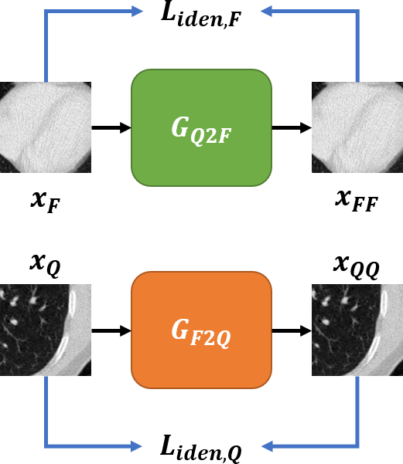
4. Implement CycleGAN – Losses
Identity loss (𝐿_{𝑖𝑑𝑒𝑛,𝐹} , 𝐿_{𝑖𝑑𝑒𝑛,𝑄})
- Prevent the target domain image from being distorted more than necessary (fixed point constraint)
^{𝐿}𝑖𝑑𝑒𝑛,𝐹 ^{= 𝔼}𝑥_{𝐹} ^{𝐺}𝑄2𝐹
^{𝐿}𝑖𝑑𝑒𝑛,𝑄 ^{= 𝔼}𝑥_{𝑄} ^{𝐺}𝐹2𝑄
𝑥_{𝐹} − 𝑥_{𝐹}
𝑥_{𝑄} − 𝑥_{𝑄}
1
1

Slide 19
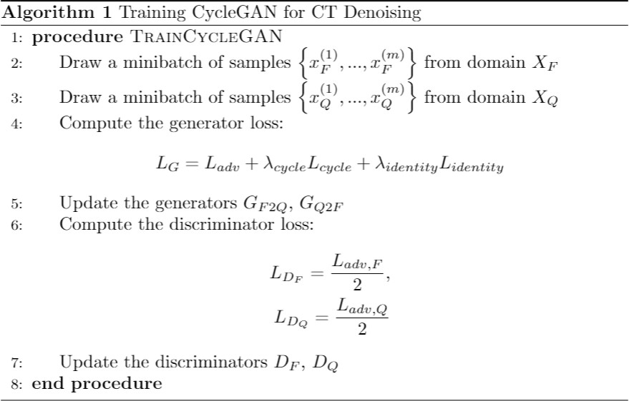
4. Implement CycleGAN – Training
𝐿_{𝐺} =
^{𝐿}𝑎𝑑𝑣,𝐹 ^{+ 𝐿}𝑎𝑑𝑣,𝑄 ^{+ 𝜆}𝑐𝑦𝑐𝑙𝑒 ^{𝐿}𝑐𝑦𝑐𝑙𝑒,𝐹 ^{+ 𝐿}𝑐𝑦𝑐𝑙𝑒,𝑄 ^{+ 𝜆}𝑖𝑑𝑒𝑛𝑡𝑖𝑡𝑦 ^{𝐿}𝑖𝑑𝑒𝑛𝑡𝑖𝑡𝑦,𝐹 ^{+ 𝐿}𝑖𝑑𝑒𝑛𝑡𝑖𝑡𝑦,𝑄
^{= 𝐿}𝑎𝑑𝑣 ^{+ 𝜆}𝑐𝑦𝑐𝑙𝑒^{𝐿}𝑐𝑦𝑐𝑙𝑒 ^{+ 𝜆}𝑖𝑑𝑒𝑛𝑡𝑖𝑡𝑦^{𝐿}𝑖𝑑𝑒𝑛𝑡𝑖𝑡𝑦
where 𝜆_{𝑐𝑦𝑐𝑙𝑒}, 𝜆_{𝑖𝑑𝑒𝑛𝑡𝑖𝑡𝑦} are weights for cycle consistency loss, identity loss
_{𝐿 =} ^{𝐿}𝑎𝑑𝑣,𝐹 _{/ 𝐿}
^{𝐿}𝑎𝑑𝑣,𝑄
=
𝐷_{𝐹}
𝐷_{𝑄}
2 2
You have to optimize generators and discriminators alternately

Slide 20
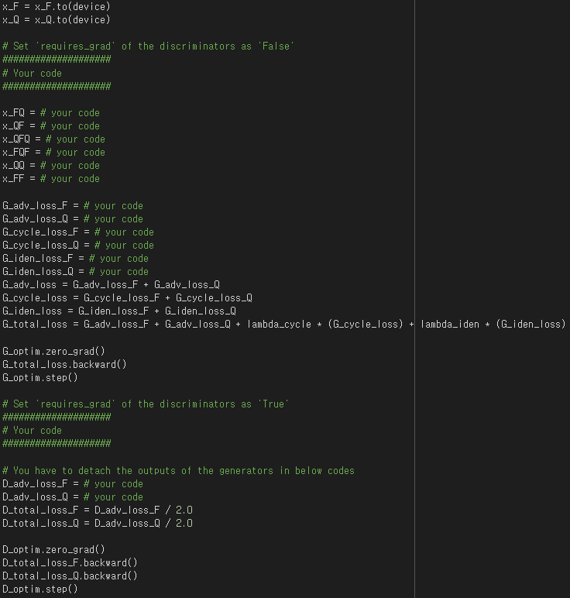
4. Implement CycleGAN – Training
You have to complete the code
Set ‘requires_grad’ of discriminators (use ‘set_requires_grad’ function)
Outputs of the networks
Loss functions of generators
Loss functions of discriminators

Slide 21
5. Report
Students will:
Train cycleGAN for CT denoising
Train supervised learning with L1 loss for CT denoising:
^{𝐿}𝑠𝑢𝑝𝑒𝑟𝑣𝑖𝑠𝑒𝑑 ^{= 𝔼}𝑥_{𝑄} ^{𝐺}𝑄2𝐹
𝑥_{𝑄} − 𝑥_{𝐹}
1
where 𝑥_{𝐹}, 𝑥_{𝑄} are full dose CT image and corresponding quarter dose CT image
Students will submit:
Executable code (with proper comments), so that TAs are able to reproduce the results
Training code for cycleGAN and supervised learning
Evaluation code + pre-trained model weights
Report about the results and methods

Slide 22
5. Report
Your report should include:
Brief explanation of the implementation (code)
Loss graph
Check if the networks converged stably.
If network reaches the optimal equilibrium state, the adversarial losses should be reached at 0.25
Qualitative evaluation
Comparison between output of cycleGAN, input, and ground truth
Comparison between output of cycleGAN and supervised learning
Quantitative evaluation
Peak signal to noise ratio (PSNR)
Structural similarity index (SSIM)
Average value of all test data (input, output of cycleGAN/supervised learning w.r.t ground truth)

Slide 23
Thank you
If you have any questions, contact me an email(leedh7@kaist.ac.kr)

